Slide 1
CS310 Operating Systems Lecture 8: Process - System Calls – exit, wait, exec
Ravi Mittal
IIT Goa

Slide 2
Acknowledgements !
Contents of this class presentation has been taken from various sources. Thanks are due to the original content creators:
Class presentation: University of California, Berkeley: David Culler, Anthony D. Joseph, John Kubiatowicz, AJ Shankar, George Necula, Alex Aiken, Eric Brewer, Ras Bodik, Ion Stoica, Doug Tygar, and David Wagner
Operating Systems: Three Easy Pieces, by Remzi and Andrea Arpaci-Dusseau,
Chapter 5: Process APIs
Programs are taken from this chapter
CS 423 Operating System Design, Uinv of Illinois, Prof Fagen-Ullmschneider
CS351 University of Washington

Slide 3
Read the following:
Operating Systems: Principles and Practice (2nd Edition) Anderson and Dahlin
Volume 1, Kernel and Processes
Chapter 4
Operating Systems: Three Easy Pieces, by Remzi and Andrea Arpaci-Dusseau,
Chapter 5: Process APIs

Slide 4
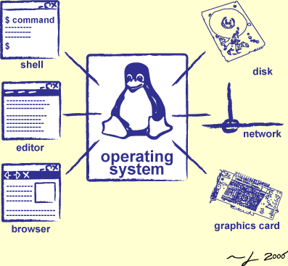
We will study..
exit() system call
wait() system call
exec* sytem calls

Slide 5
We have studied so far …

Slide 6
System Calls (“Syscalls”)
Word Processing
Compilers
Web Browsers
Email
Databases
Web Servers
Application / Service
Portable OS Library
OS
User
System Call
Interface
System
Portable OS Kernel
Software
Platform support, Device Drivers
Hardware
x86
PowerPC
ARM
PCI
Ethernet (1Gbs/10Gbs)
802.11 a/g/n/ac
SCSI
Graphics
Thunderbolt
Crooks & Joseph CS162 © UCB Spring 2021

Slide 7
OS Library Issues Syscalls
Proc 1
Proc 2
Proc n
…
OS
Appln
login
Window Manager
…
libc
OS library
OS library
OS library
OS
Crooks & Joseph CS162 © UCB Spring 2021

Slide 8
System Calls

Slide 9
Process Related System Calls (in Unix)
fork() creates a new child process
All processes are created by forking from a parent
The init process is ancestor of all processes
exec() makes a process execute a given executable
exit() terminates a process
wait() causes a parent to block until child terminates
There are many variants of the above system calls with different arguments
Last class

Slide 10
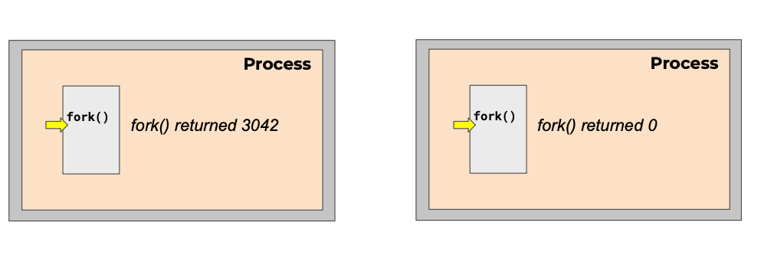
Creating a process
Just one process – Parent process
Initially there is one process – init with id = 1
id = 1
id = 3042
ppid() = 1
CS 423 Operating System Design, Uinv of Illinois, Prof Fagen-Ullmschneider

Slide 11
System Calls – exit() and wait()

Slide 12
Process termination
Multiple ways for a process to get destroyed
Process issues and exit() call – Voluntary
The parent process issues a kill() call - Involuntary
Process receives a terminate signal - Involuntary
When it did something illegal !
On death
Reclaim all of process’s memory regions
Make process un-runnable
Put the process in the zombie state (will discuss it later)
However, do not remove its process descriptor from the list of processes

Slide 13
Waiting for children to die with wait()
The parent can wait for the child to die by executing the wait system call
It is quite useful for a parent to wait for a child process to finish what it has been doing
on success, returns the process ID of the terminated child; on error, -1 is returned.

Slide 14
wait and waitpid syscalls
A terminated process’s information is collected via a call of a wait operation by its parent
Operations:
wait
blocks the calling process until a child process terminates, returning the child’s pid
If caller has no children, wait immediately returns –1 (error)
the termination status (return value) of the child may be obtained via the argument
waitpid
permits a caller to wait for a particular child, identified by its pid

Slide 15
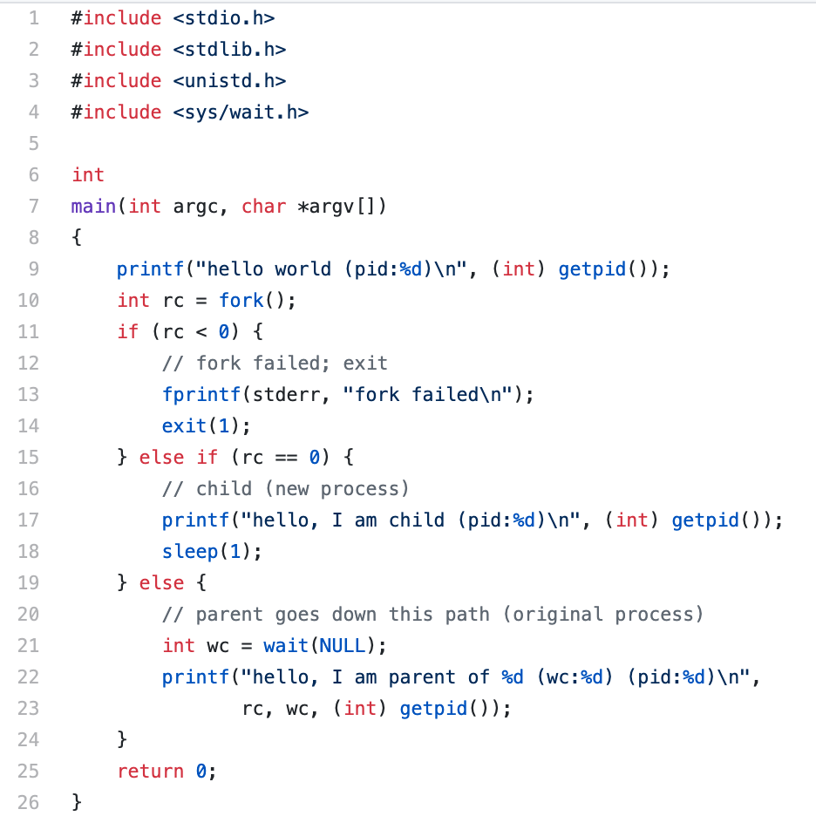
wait() system call
p2.c

Slide 16
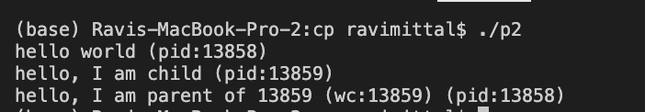
wait() system call
Parent process waits for the child to finish

Slide 17
System Calls –exec family

Slide 18
Executing a new program
After fork, parent and child are running same code
Not too useful!
A common use of fork is to launch a new executable program
A process can run exec() to load another executable to its memory image
So, a child can run a different program from parent
It can also be shell script
The exec system call replaces the current process image with a new image
If exec succeeds, it never returns
exec requires you to specify the file you program to run

Slide 19
exec() system call
The exec family of system calls replaces the program executed by a process
When a process calls exec, all code (text) and data in the process is lost and replaced with the executable of the new program
All open file descriptors remains open after calling exec
unless explicitly set to close-on-exec

Slide 20
The exec()System Call
There’s no a syscall under the name exec(). By exec() we usually refer to a family of calls:
int execl(char *path, char *arg, ...);
int execv(char *path, char *argv[]);
int execle(char *path, char *arg, ..., char *envp[]);
int execve(char *path, char *argv[], char *envp[]);
int execlp(char *file, char *arg, ...);
int execvp(char *file, char *argv[]);
Here's what l, v, e, and p mean:
l means an argument list,
v means an argument vector,
e means an environment vector, and
p means a search path.

Slide 21
execvp() system call
#include <unistd.h>
int execvp(const char *file, char *const argv[]);
file: Used to construct a pathname that identifies the new process image file
If the file argument contains a slash character, the file argument is used as the pathname for the file
argv: An array of character pointers to NULL-terminated strings
These strings constitute the argument list available to the new process image
argv[0] must point to a filename that's associated with the process being started
the last member of this array is a NULL pointer

Slide 22
Exec-ing a new program
Stack
Very high-level diagram of what happens when you run the command “ls” in a Linux shell:
This is the loading part of CALL!
Heap
Data
Code: /usr/bin/bash
fork()
parent
child
child
Stack
Stack
Stack
exec*()
Heap
Heap
Data
Data
Data
Code: /usr/bin/bash
Code: /usr/bin/bash
Code: /usr/bin/ls
CS351 Univ of Washington
Notes:
DEMO: ps -ef and pstree.

Slide 23
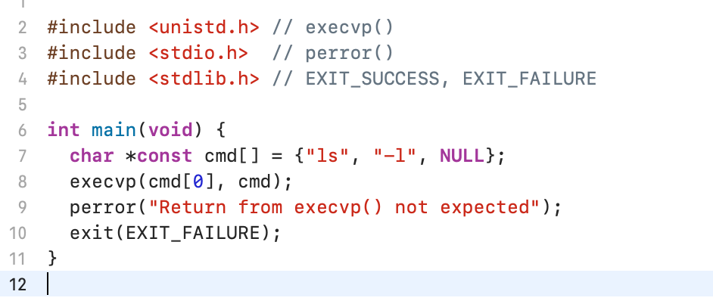
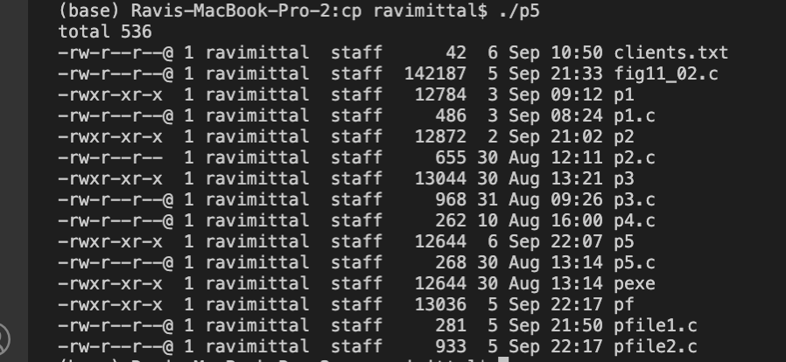
Example: Using execvp()
p5.c

Slide 24
p3.c
#include <unistd.h>
#include <string.h>
#include <sys/wait.h>
int
main(int argc, char *argv[])
{
printf("hello world (pid:%d)\n", (int) getpid());
int rc = fork();
if (rc < 0) {
// fork failed; exit
fprintf(stderr, "fork failed\n");
exit(1);
} else if (rc == 0) {
// child (new process)
printf("hello, I am child (pid:%d)\n", (int) getpid());
char *myargs[3];
myargs[0] = strdup("wc"); // program: "wc" (word count)
myargs[1] = strdup("p3.c"); // argument: file to count
myargs[2] = NULL; // marks end of array
execvp(myargs[0], myargs); // runs word count
printf("this shouldn't print out");
} else {
// parent goes down this path (original process)
int wc = wait(NULL);
printf("hello, I am parent of %d (wc:%d) (pid:%d)\n",
rc, wc, (int) getpid());
}
return 0;
}

Slide 25
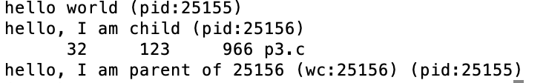
Program Output

Slide 26
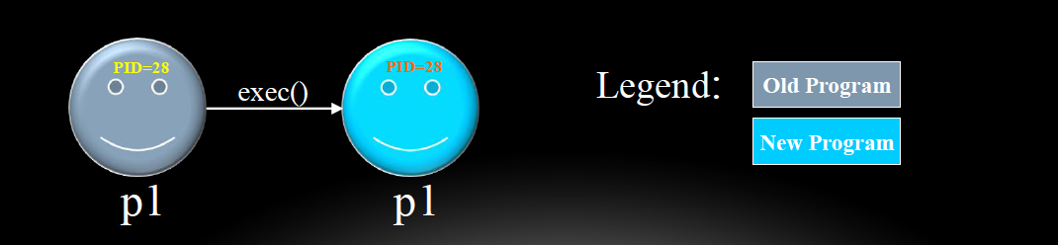
exec() – more info
Upon success, exec() never returns to the caller
A successful exec replaces the current process image, so it cannot return anything to the program that made the call
If it does return, it means the call failed. Typical reasons are: non-existent file (bad path) or bad permissions
As a new process is not created, the process identifier (PID) does not change
However, machine code, data, heap, and stack of the process are replaced by those of the new program

Slide 27
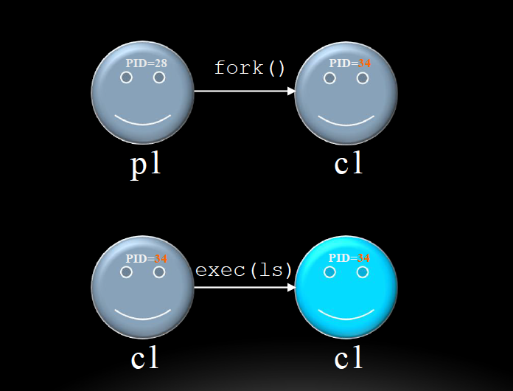
fork() and exec() combined
Often after doing fork() we want to load a new program into the child

Slide 28
Zombies
A terminated process still consumes system resources
Various tables maintained by OS
Called a “zombie” (a living corpse, half alive and half dead)
Reaping is performed by parent on terminated child
Parent is given exit status information and kernel then deletes zombie child process
What if parent doesn’t reap?
If any parent terminates without reaping a child, then the orphaned child will be reaped by init process (pid of 1)
Note: on recent Linux systems, init has been renamed systemd
In long-running processes (e.g. shells, servers) we need explicit reaping

Slide 29
Zombie State
Why keep process descriptor around?
Parent may be waiting for child to terminate
via the wait() system call
Parent needs to get the exit code of the child
this information is stored in the descriptor (PCB)
If descriptor was destroyed immediately, this information could not be gotten
After getting this information, the process descriptor (PCB) can be removed
no more remnants of the process

Slide 30
Class Summary
fork makes two copies of the same process (parent & child)
Returns different values to the two processes
exec* replaces current process from file (new program)
Two-process program:
First fork()
if (pid == 0) { /* child code */ } else { /* parent code */ }
Two different programs:
First fork()
if (pid == 0) { execv(…) } else { /* parent code */ }
wait or waitpid used to synchronize parent/child execution and to reap child process

Slide 31
fork() AND exec() combined (1/2)

Slide 32
exec() – More info
The exec()call replaces a current process’ image with a new one (i.e. loads a new program within current process)
The new image is either regular executable binary file or a shell script
There is not a syscall under the name exec(). By exec()we usually refer to a family of calls:
int execl(char *path, char *arg, ...);
int execv(char *path, char *argv[]);
int execle(char *path, char *arg, ..., char *envp[]);
int execve(char *path, char *argv[], char *envp[]);
int execlp(char *file, char *arg, ...);
int execvp(char *file, char *argv[]);
Here's what l, v, e, and p mean:
l means an argument list,
v means an argument vector,
e means an environment vector, and
p means a search path.

